Slide 1

6-aside Rockborne Football League: An insight
By James Bright and Callum O’Neill

Slide 2

CONTENT
Project Brief
ER Design
Implementation
Testing
Reflection

Slide 3
Project Brief
Rockborne has organised a 6-aside football tournament throughout autumn
4 teams
8 groups participating
3 for a win, 1 for a draw, 0 for a loss
Task:
TO CREATE A RELATIONAL DATABASE THAT STORES ALL THE DATA REGARDING PLAYERS, MATCH DETAILS/EVENTS AND FINAL SCORE

Slide 4
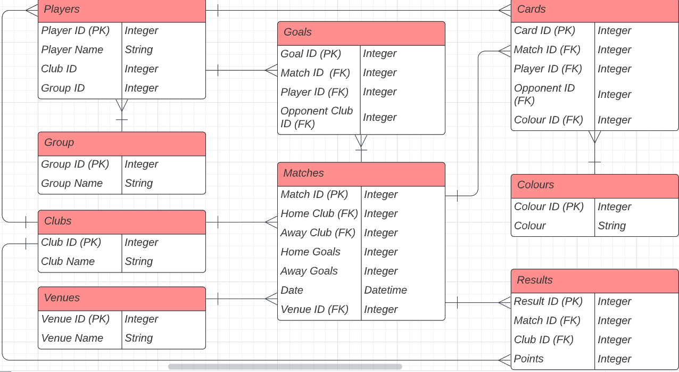
ER Design
All Entities
Data produced from a match
Structured data
Each related entities: many-to-one or one-to-many
Conceptual Schema: Primary Keys (Cards, goals, Results)
Logical Schema: IDs, Player names, club names
Physical Schema: integers, strings

Slide 5
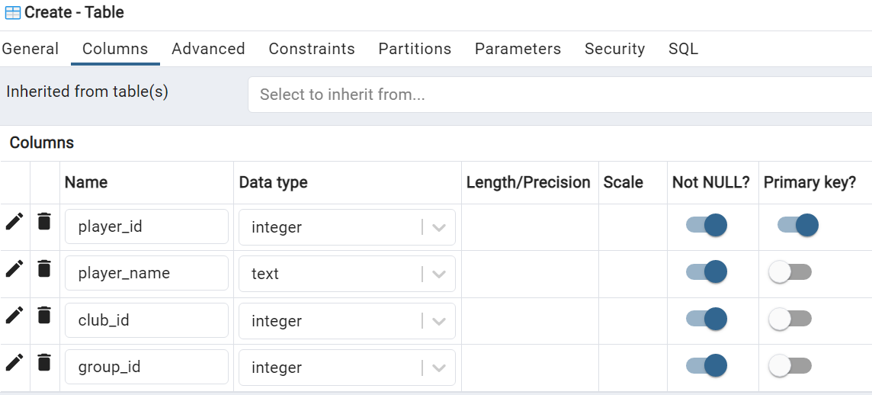
Implementation
DDL (Schema Definition)
Use of graphical user interface
Table Creation on PgAdmin 4:
On Schemas
1)Tables
2)Create
3)*Insert conceptual, logical, physical schema
4)Primary Keys
Could also use query tool

Slide 6
Implementation
DML (Data Manipulation Language)
Example of Data import (DML):
COPY venues(venue_id, venue_name) FROM 'C:\Users\JamesBright\OneDrive - Harnham Search and Selection Ltd\Documents\0. Training\1. SQL\Fotball Task\venues.csv' WITH NULL AS 'null' DELIMITER ',' CSV HEADER;
-Same code applied to all
Tables, tuples and attributes.
-Tweaks made to get the relevant fields

Slide 7
Data Dictionary
Data Dictionary
General overview of the Rockborne Football Tournament database
Constraints:
-PK (Primary Key) – main constraint
-Not Null – indicates records within fields that “Absolutely cannot” be Null
Example field: represents what data
Can be expected within each record.

Slide 8

Case Questions
1)Listing all students who play for a particular department
2)Listing all fixtures for a specific date
3)Listing all the players who have scored more than 2 goals
4)Return the total number of goals scored in the season
5)Return the number of goals in favour, goals against, goals difference and points by team
6)Listing number of cards (yellow and red) per team
7)Return the games that are going to be played (friendly matches)
8)Develop a store procedure to add new players. It needs to consider warnings and exceptions

Slide 9
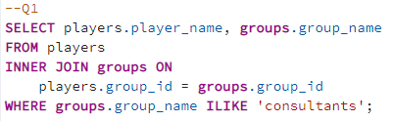
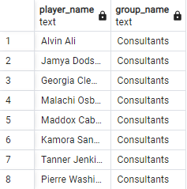
Question 1

Slide 10
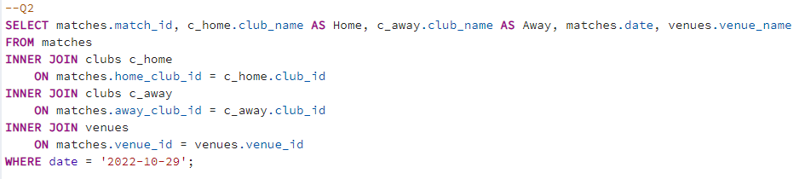

Question 2

Slide 11
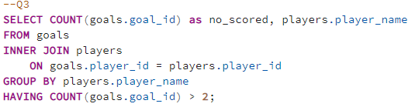
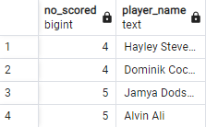
Question 3

Slide 12


Question 4

Slide 13
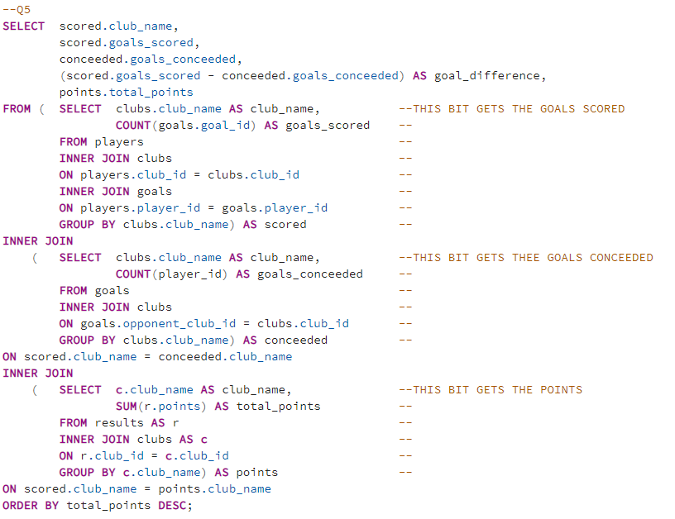
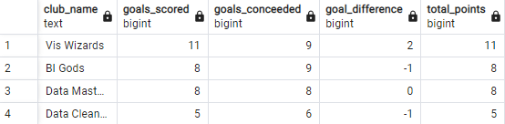
Question 5

Slide 14
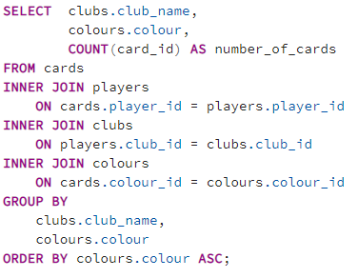
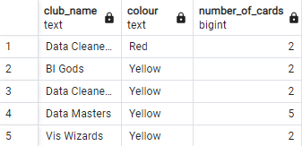
Question 6

Slide 15
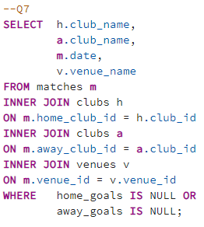

Question 7

Slide 16
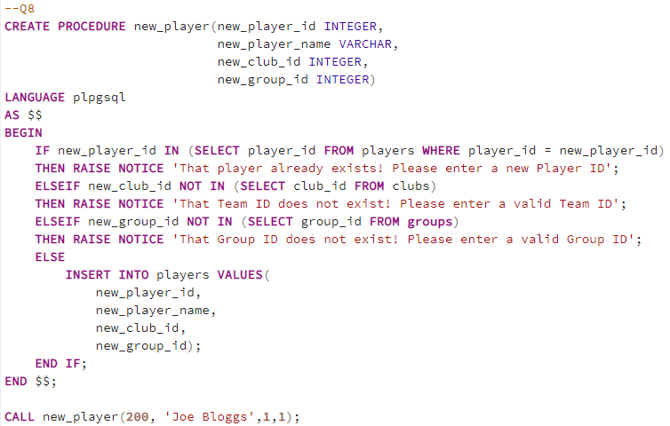
Question 8

Slide 17
Reflection, Conclusions + Lessons Learned
Lessons Learned
-First hand exp of relational design
-Lucid Chart
-Strong idea how entities relate
-Importance of collaboration (not time efficient to do it solo)
ER DESIGN
Creating Databases, Tables on pg admin
populating data via excel exports
DML
Standard ETL/ELT strategy
Implementation
Testing
Problem solving with SQL
code debugging
“Trial and Error”
Best output using least amount of code

Slide 18
Conclusions and reflections
Data Cleaners need to monitor player behaviour – Highest accumulated cards. Incl. the most reds
Alvin Ali and Jamya Dodson were leading goal scorers
Drafting a relational database is a difficult process but a rewarding one

Slide 19
RECAP
Relational Database Design
Loading and Transforming Data
-Aggregations
-Counts
-Validation
Solving Case related questions using queries

Slide 20
THANKS FOR LISTENING!
QUESTIONS?

